Slide 1

High-density Mobile Cloud Gaming on Edge SoC Clusters
2024 USENIX Annual Technical Conference
Li Zhang, Shangguang Wang, Mengwei Xu
Beijing University of Posts and Telecommunications (BUPT)

Slide 2
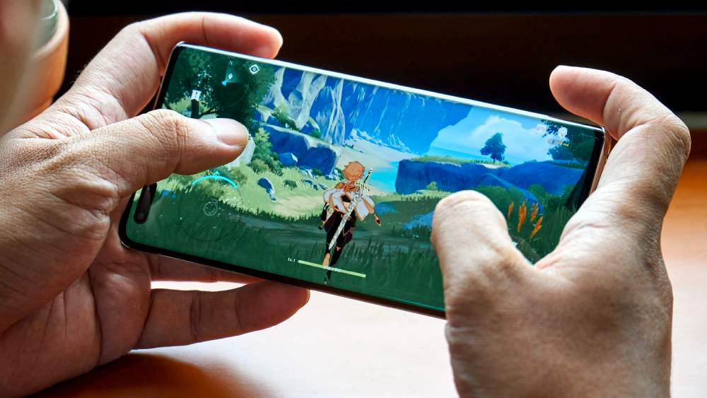
Mobile Games
Mobile games: A popular and portable form of entertainment on daily smartphones
Huge and growing market: An estimate of 100 billion USD revenue globally
Source: https://www.statista.com/outlook/dmo/digital-media/video-games/mobile-games/worldwide

Slide 3

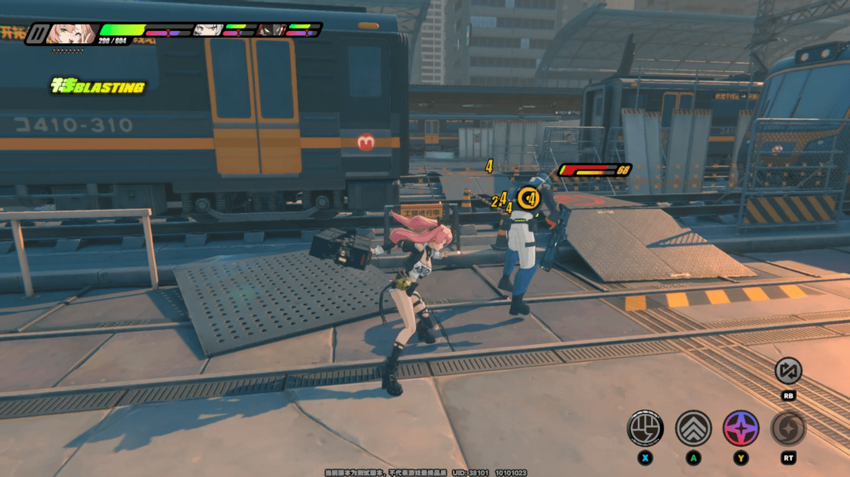
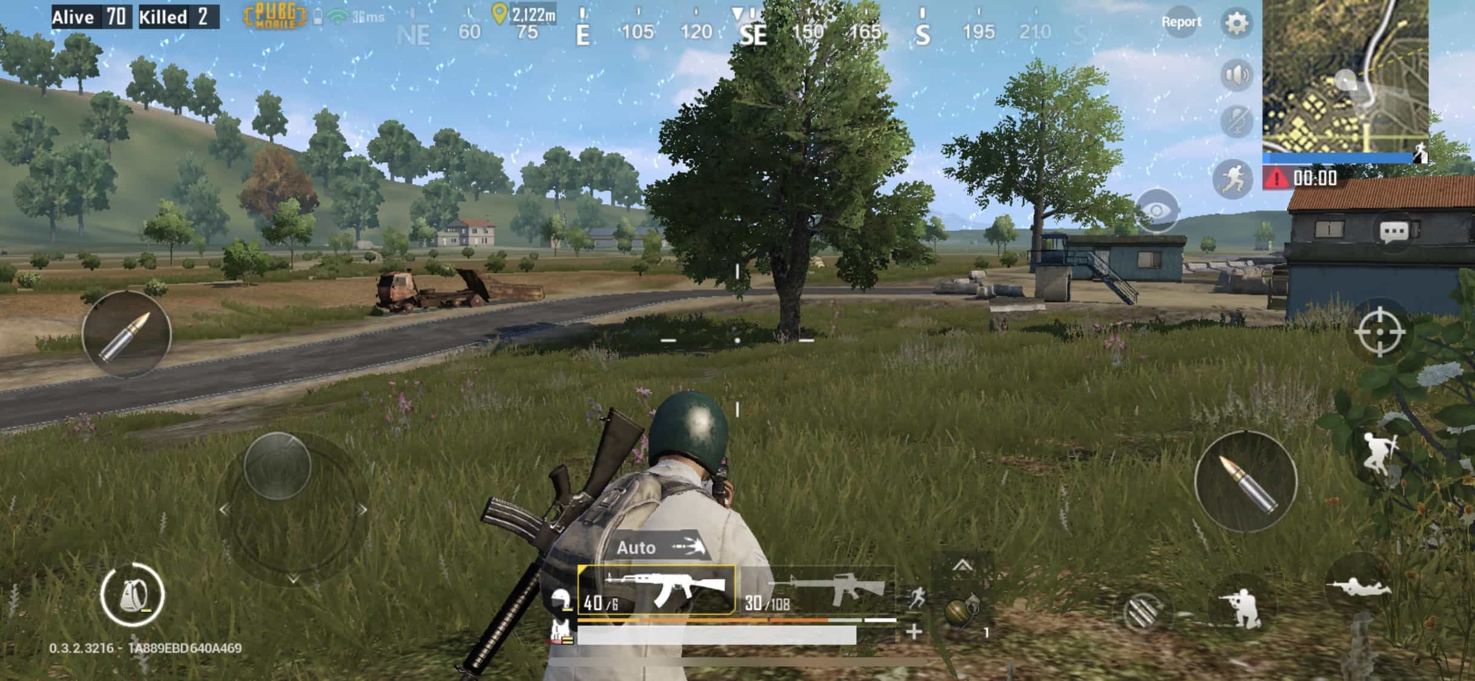
Mobile Games: Huge Resource Requirements
Better gaming experiences call for huge hardware resources.
Games are becoming “bigger” and “more complex”; fully load the latest, powerful mobile processors.
These new, resource-consuming mobile games retire old smartphones sooner or later!

Slide 4



Mobile Cloud Gaming Services
Better gaming experiences call for huge hardware resources.
Games are becoming “bigger” and “more complex”; fully load the latest, powerful mobile processors.
Instant access
High compatibility
Immersive game experience
Reduced hardware cost
Network
End Users
Mobile Cloud Gaming Infrastructure

Slide 5

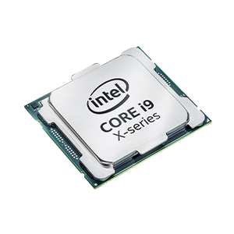

Mobile Cloud Gaming Infrastructure
Traditional approach: Mobile environment emulation on Intel/ARM CPUs with server-level GPUs (e.g., NVIDIA GPUs)
Mobile Gaming Instances
Pros: Share the same hardware as other general workloads
Cons:
Performance loss: OS emulation required
Low flexibility, huge human efforts: Require game reengineering to solve compatibility and performance issues
Limited game availability: Game developers may not provide app packages for other hardware architecture (e.g., x86)
Android OS Emulation
Windows/Linux OSes
Traditional Approach

Slide 6
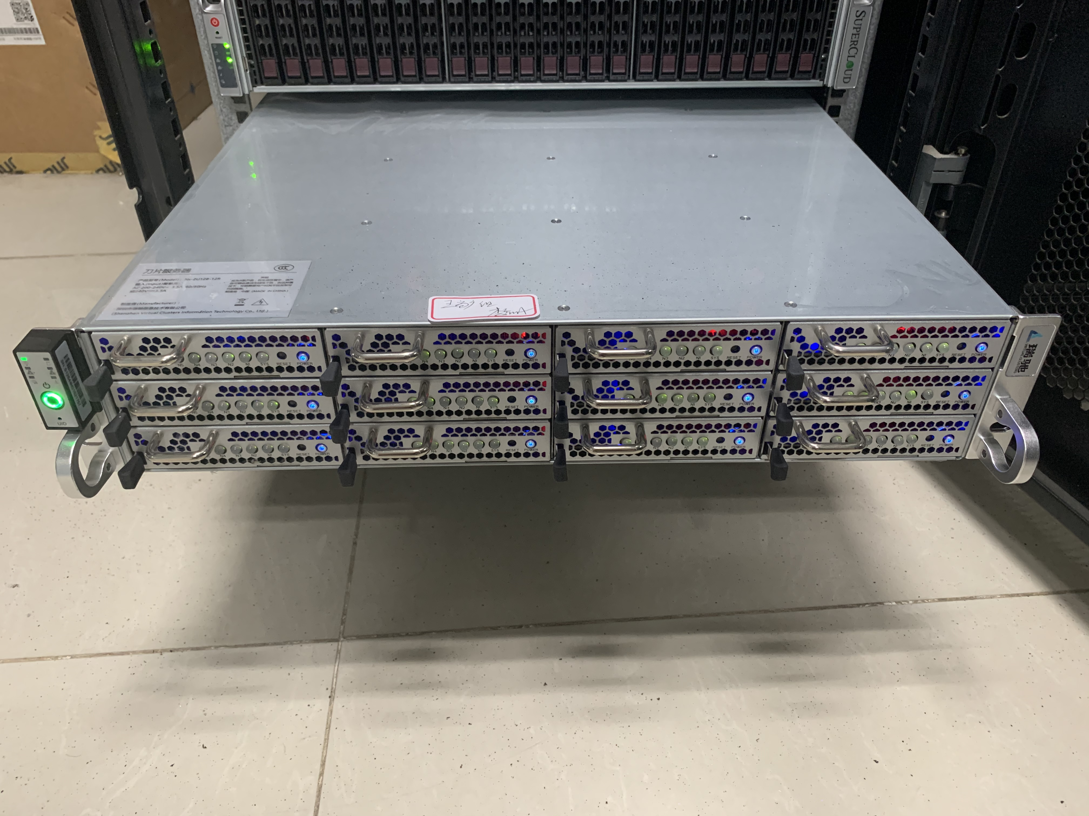


Mobile Cloud Gaming Infrastructure
System-on-Chip Clusters: Group multiple mobile processors inside a server; provide identical mobile environments as on user smartphones.
The same mobile context: No OS/game modification required
Easy of deployment: Games are optimized for a single mobile processor
Mobile Gaming Instances
Native Android OSes
What are the drawbacks of using SoC Clusters?
System-on-Chip Clusters

Slide 7

Low Game Deployment Density
Conservative game deployment methods
Dedicated deployment: Deploy one game instance per mobile SoC.
Game co-location: Co-locate multiple game instances on the same mobile SoC through pre-profiling.
Dedicated Deployment
Game Co-location
Game Session
Game Session
Game Session
Game Session
Android OS
*N
Android OS
Android OS
Android OS

Slide 8
Low Game Deployment Density
Conservative game deployment methods
Dedicated deployment: Deploy one game instance per mobile SoC.
Game co-location: Co-locate multiple game instances on the same mobile SoC through pre-profiling.
Experiment on five commercial mobile games
Four out of all five games can only run one game session.
A huge resource waste when only one game session is running.
Wasted resources: > 50% CPU and > 25% GPU

Slide 9
Low Game Deployment Density
Conservative game deployment methods
Dedicated deployment: Deploy one game instance per mobile SoC.
Game co-location: Co-locate multiple game instances on the same mobile SoC through pre-profiling.
Experiment on five commercial mobile games
Four out of all five games can only run one game session.
A huge resource waste when only one game session is running.
Limited GPU resources per SoC bottleneck game deployment density.
GPU bottlenecks!

Slide 10
Increased Resource Requirements of Games
Top 30 mobile games from Google Play Store
Average CPU/GPU load under medium/high graphics settings
Average CPU/GPU load aggregated by games’ release years
Mobile games primarily utilize GPU resources compared to CPU.
The GPU resource requirements is still increasing, potentially surpassing the capabilities of current SoCs.
Notes:
Besides, the increased resource requirements of mobile games also

Slide 11
Goal of this Work
Our goal: Run more mobile game within limited hardware resources of mobile SoCs.
Similar to the goal of traditional cloud gaming systems!
Their approach: They partition complete game instances, but in the cloud, they all consume a bunch of resources.
Run a full game copy.
Run a partial game instance, which still consumes a lot of resources.
How well do previous cloud gaming systems perform here?

Slide 12
Revisit Prior Game Partitioning Designs
[ASPLOS’20] Coterie: Exploiting Frame Similarity to Enable High-Quality Multiplayer VR on Commodity Mobile Devices
Split the whole game world into a near part and a remote part.

Slide 13
Revisit Prior Game Partitioning Designs
[ASPLOS’20] Coterie: Exploiting Frame Similarity to Enable High-Quality Multiplayer VR on Commodity Mobile Devices
Split the whole game world into a near part and a remote part.
Trivial GPU load reduction at the remote game part.
Even higher accumulated GPU load after game partitioning.

Slide 14
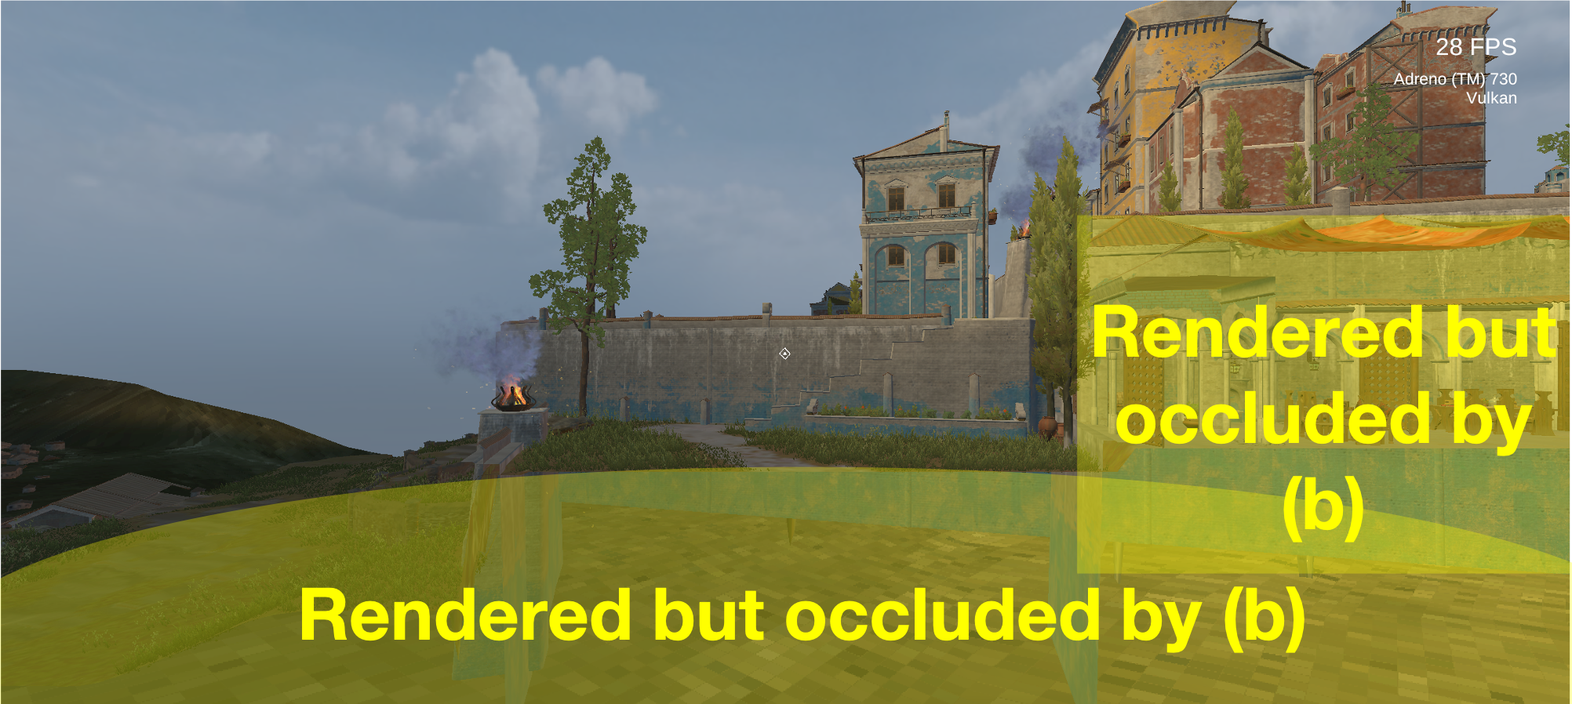
Revisit Prior Game Partitioning Designs
[ASPLOS’20] Coterie: Exploiting Frame Similarity to Enable High-Quality Multiplayer VR on Commodity Mobile Devices
Split the whole game world into a near part and a remote part.
The occluded areas are unnecessarily rendered after game partitioning.
Preserve the optimizations brought by the default graphics rendering pipeline.

Slide 15
Our System: SFG
A simple yet efficient partitioning method: Partition graphics rendering workloads before rendering (like the sort-first rendering^{[1]})
More flexibility: Use an abstracted rectangle to represent the target area for rendering; Runtime adjustment
[1] Steven Molna et al. A sorting classification of parallel rendering. IEEE computer graphics and applications,1994.

Slide 16
Our System: SFG
NPU-enhanced game partition coordination to handle game usage dynamics
Assumption: Render native frames first; then use frame super-resolution on SoC NPUs if there is no GPU resource left
Approach: A two-stage coordination
✅ All meet the FPS
Stage #1: Shifting GPU rendering workloads to make all game sessions on one of the SoCs meet the target (every 500 ms).
Stage #1: Partition Coordination
Game Session
Partial Game
Game Session
Partial Game
Game Session
Game Session
Android OS
Android Container
Android OS
Android Container
Android OS
Android OS

Slide 17
Our System: SFG
NPU-enhanced game partition coordination to handle game usage dynamics
Assumption: Render native frames first; then use frame super-resolution on SoC NPUs if there is no GPU resource left
Approach: A two-stage coordination
Stage #1: Shifting GPU rendering workloads to make all game sessions on one of the SoCs meet the target (every 500 ms).
Stage #2 (optional): Apply frame super-resolution on a partial game session if game sessions on one of the SoC do not meet the FPS.
Game Session
Partial Game
Android OS
Android Container
Stage #2: Frame Super-resolution on NPU
Integrated NPU

Slide 18
Evaluation
Implementation
A Unity Plugin that can be easily integrated into any Unity-based games
Game partitioning: Unity’s Camera API
Game states and rendering results synchronization: WebRTC
Frame super-resolution: The quantized ETDS^{[1]} model; TFLite on SoC NPUs
[1] Chao et al., Equivalent Transformation and Dual Stream Network Construction for Mobile Image Super-Resolution. CVPR 2023

Slide 19
Evaluation
Implementation
A Unity Plugin that can be easily integrated into any Unity-based games
Game partitioning: Unity’s Camera API
Game states and rendering results synchronization: WebRTC
Frame super-resolution: The quantized ETDS^{[1]} model; TFLite on SoC NPUs
Software
Games: Five open-source Unity games with varied graphics settings
Game | Resolution | FPS | Feature
Sun Temple | 1920 * 1080 | 30 | Infrequent scene switch
Corridor | 1280 * 720 | 30 | Fast scene switch
Sewer Mid | 1920 * 1080 | 60 | Medium scene switch
Sewer High | 2560 * 1440 | 60 | Medium scene switch
Viking Village | 1920 * 1080 | 30 | High dynamics, fast scene switch

Slide 20
Evaluation
Implementation
A Unity Plugin that can be easily integrated into any Unity-based games
Game partitioning: Unity’s Camera API
Game states and rendering results synchronization: WebRTC
Frame super-resolution: The quantized ETDS^{[1]} model; TFLite on SoC NPUs
Software
Games: Five open-source Unity games with varied graphics settings
Game play simulation: Manually recorded interactive scripts powered by Unity’s animation system; replayed at game runtime for deterministic interaction.
Hardware
An SoC Cluster consisting of 60 Qualcomm Snapdragon 865 SoCs; Android 10 OS
1 Gbps network bandwidth between individual SoCs

Slide 21
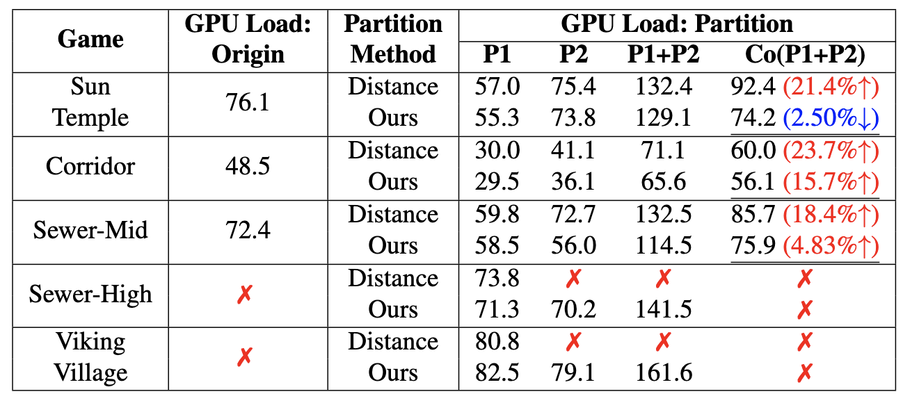
Effectiveness of Game Partitioning Design
Baseline: Distance-based game partitioning proposed in Coterie
Our partition design
Reduces the GPU load by an average of 15%.
Enables running games on two SoCs that cannot be supported on individual ones.

Slide 22
Effectiveness of Game Partitioning Design
Baseline: Distance-based game partitioning proposed in Coterie
Our partition design
Reduces the GPU load by an average of 15%.
Enables running games on two SoCs that cannot be supported on individual ones.
✅
Deployable on two SoCs!
✅

Slide 23
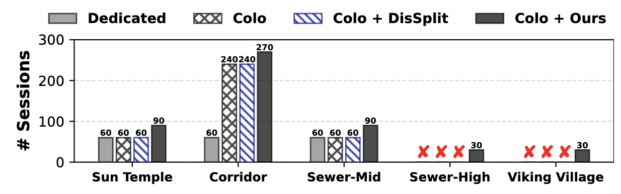
End-to-end Game Deployment
Baselines
Dedicated deployment: One game instance per SoC.
Game co-location: One or more game instance per SoCs.
Game co-location with distance-based game partitioning
Game co-location with our system
Game deployment density on a whole SoC Cluster (60 SoCs)
Support games exceeding the capacity of one SoC.

Slide 24

End-to-end Game Deployment
Baselines
Dedicated deployment: One game instance per SoC.
Game co-location: One or more game instance per SoCs.
Game co-location with distance-based game partitioning
Game co-location with our system
Game deployment density on a whole SoC Cluster (60 SoCs)
Support games exceeding the capacity of one SoC.
Up to 4.5x improvement over dedicated deployment.
Up to 1.5x improvement over previous co-location methods.
4.5x
1.5x
1.5x

Slide 25
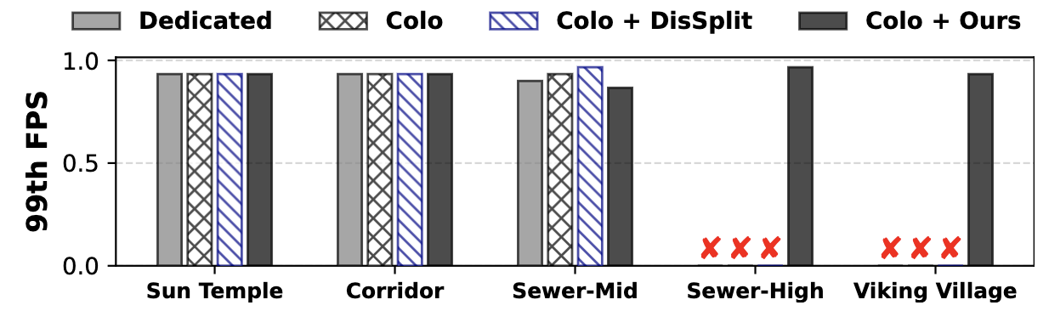
End-to-end Game Deployment
Game performance (FPS)
Trivial game performance reduction on Sewer-Mid: Average FPS drops from 54 to 52. ^{(Target FPS: 55)}

Slide 26
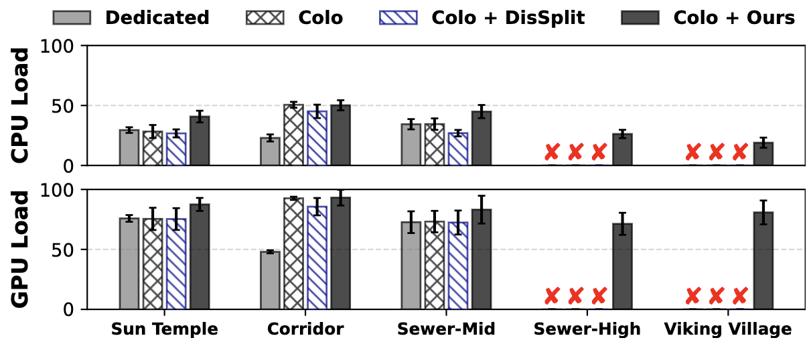
End-to-end Game Deployment
Hardware load
GPU load: 22% increase compared to dedicated deployment; 7.5% increase compared to game co-location.
The average GPU load reaches 97%.
The additional CPU costs incurred by duplicate game logic is manageable by a single SoC.

Slide 27
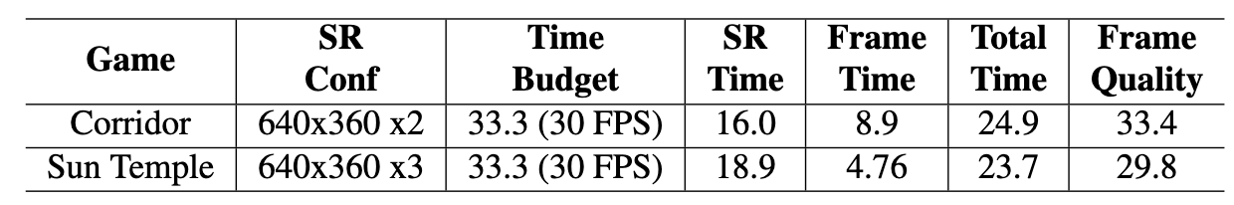
End-to-end Game Deployment
Frame super-resolution
Frame super-resolution is a complementary solution for GPU shortage.
2 out of all 5 games, 16% of all game sessions involve frame super-resolution.
The frame super-resolution process can be injected into the frame rendering process (the overall latency is less than the time budget for rendering a frame).
Satisfactory frame quality (a PSNR value larger than 30).
Mobile NPUs are still fast growing! (15 TOPS on Snapdragon 865 SoC vs. the latest Snapdragon 8 Gen 3)

Slide 28
Conclusion
Reveal the status quo of mobile cloud gaming on SoC Clusters.
The first system for high-density mobile cloud gaming on SoC Clusters.
Two simple yet efficient techniques
Pre-rendering game partitioning
NPU-enhanced game partitioning coordination mechanism
Improvement in game deployment density and the ability to support games that cannot be supported by an individual SoC.
SFG Code: https://github.com/lizhang20/SFG
High-density Mobile Cloud Gaming on Edge SoC Clusters
Li Zhang, Shangguang Wang, Mengwei Xu
Beijing University of Posts and Telecommunications (BUPT)

